Slide 1

TEAM MEMBERS
Dhanush M
Haarith P
Venkat A

Slide 2

The domain of our project is

Slide 3
INTRODUCTION
Cryptocurrency is a digital payment system that doesn't rely on banks to verify transactions. It’s a peer-to-peer system that can enable anyone anywhere to send and receive payments. Instead of being physical money carried around and exchanged in the real world.

Slide 4
ABSTRACT
The project is to develop a website for analyzing the Crypto currencies. The website analyze the current & previous values, history, market shares, investments and other technical indicators like graphs, market position etc.of the user’s interested coin. It make suggestions about the do's and dont’s according to the current trends in the market. Suggestion about when and which coin the user should invest.
This paper explains the working of the linear regression and Long Short-Term Memory model in predicting the value of a Bitcoin.

Slide 5
PROBLEM STATEMENT
Everybody wants to grow their money by investing in the stock market, but with the growing technology and the introduction of e-money what can be a better way to make your money grow by investing in crypto currency? Bitcoin or any other crypto currency is not under the influence of any country or government, for this reason, it can be invested by anyone around the globe without the fear of being imposed of taxes from other countries.

Slide 6
METHODOLOGY & ALGORITHM USED
Data Collection is the first step we take in order to start any project. It is defined as the procedure of collecting, measuring, and analyzing accurate insights for research using standard validation techniques. An analyst would then be able to assess their theory dependent on gathered information. By and large, information assortment is the essential and most significant advance for research, independent of the field of examination.

Slide 7
LINEAR REGRESSION
This technique is used to identify the relationship between dependent and independent variables and is leveraged to predict future outcomes. When we use only one dependent and one independent variable then it is called the simple linear regression.

Slide 8
Long Short-Term Memory (LSTM)
It is a deep learning concept or particularly a Recurrent Neural Network concept that avoids the vanishing gradient problem. The main reason for using this algorithm is that it avoids the back propagation error from vanishing or exploding, instead, these errors can flow backward through an unlimited number of virtual layers unfolded in space.
LSTM mainly works on time series graphs with data sets that consist of events that occur thousands or millions of discrete-time steps earlier. It works with given long delays between significant events and can also handle signals with a mixture of low and high- frequency components.
Over a lot of researchers have used LSTM to predict time series related data sets for stock prediction and have achieved greater or higher accuracy compared to other algorithms.

Slide 9
FUTURE ENHANCEMENTS
To work on a better User Interface so that people can access these data easily and effortlessly.
Implementing IOT model for smart automatic analysis.
Implementing more algorithms to find out the best method for predicting the crypto currency

Slide 10

ADVANTAGES
Gives a clarity about the crypto market
Saves the trader’s time
Gives good suggestions based on the movements in crypto market.

Slide 11
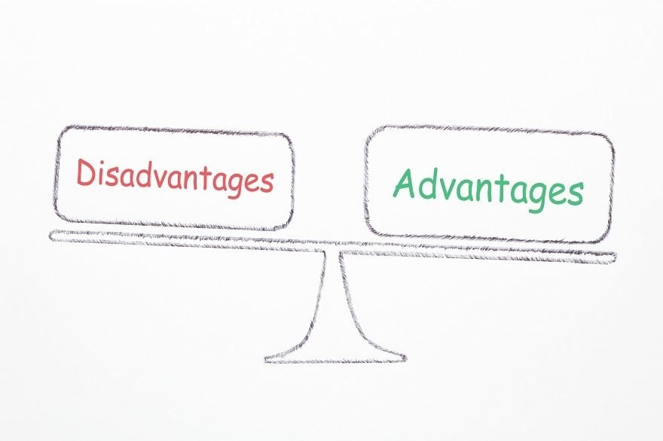
DISADVANTAGES
The analysis can be wrong at sometimes as the results are machine calculated.
Depends on the outside source for the information.

Slide 12
THANK YOU

